Slide 1
Building Your Memory Analysis Toolkit
Notes:
Presenter
2017-03-24 15:22:33
--------------------------------------------
Hello and welcome to “Understanding and Solving Memory Problems” authored by Richard Warburton. Normally when we think about the best to write Java code we’re often thinking about the maintainability of the software – for example does it follow OOP best practices, is it well tested, can you add features easily. This course is a bit different, and in many ways more exciting than that. It talks about the kind of problems that can happen to well factored and tested code in production. We’ll be categorising and explaining a series of problems that are related to memory and we’ll demonstrate how you can use freely available tooling and battle-tested approaches to solve these problems.

Slide 2


Slide 3
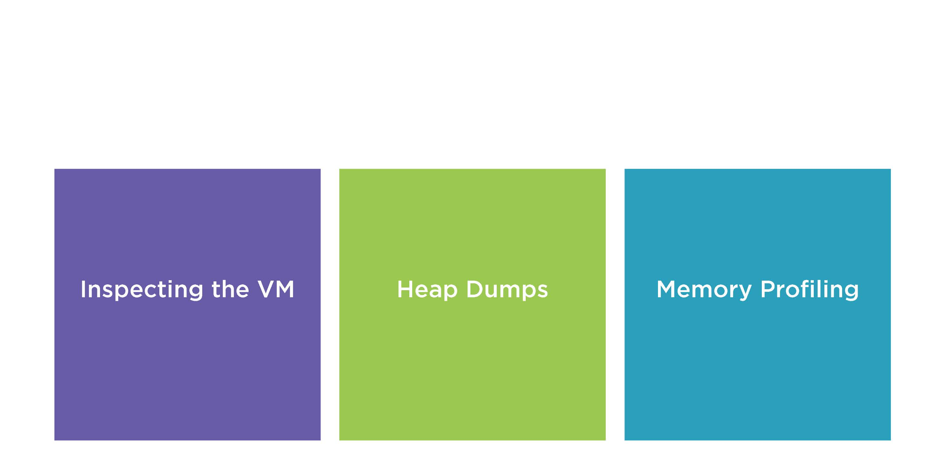

Slide 4
How to Inspect the JVM

Slide 5

Demo
jps
Ships with the JVM Can list running JVMs Commandline Tool

Slide 6
Demo
JvisualVM
Ships with the JVM Very versatile tool GUI

Slide 7
Object Histogram
A listing of how much memory is used by different types of objects

Slide 8



Object Histograms
Snapshot What is in the heap
currently
Quick Very fast to collect
Low Detail Doesn't list cause or objectrelationships

Slide 9


Slide 10
Heap Dumps

Slide 11
Heap Dump
A copy of all live objects in the application’s heap

Slide 12


What is a Heap Dump?
Snapshot What is in the heap
currently
Slow &Large Requiresspaceto
store and time to take thedump
High Detail Object relationships andperobject
memory

Slide 13
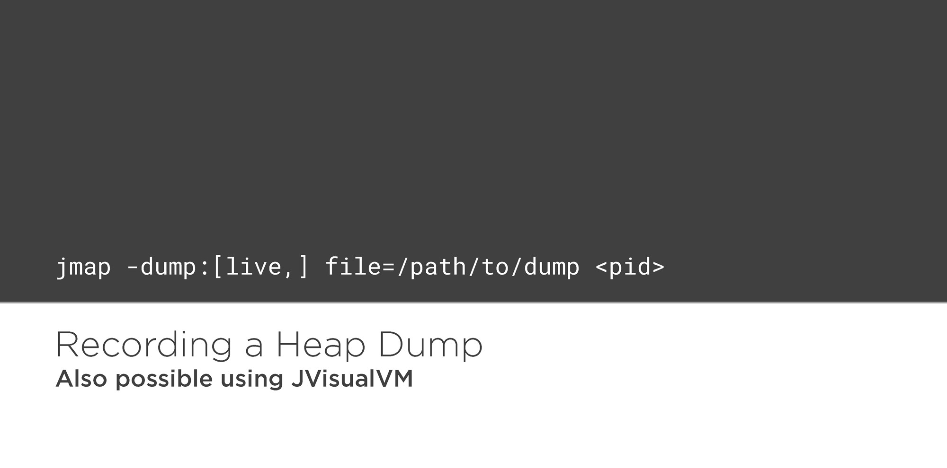

Slide 14
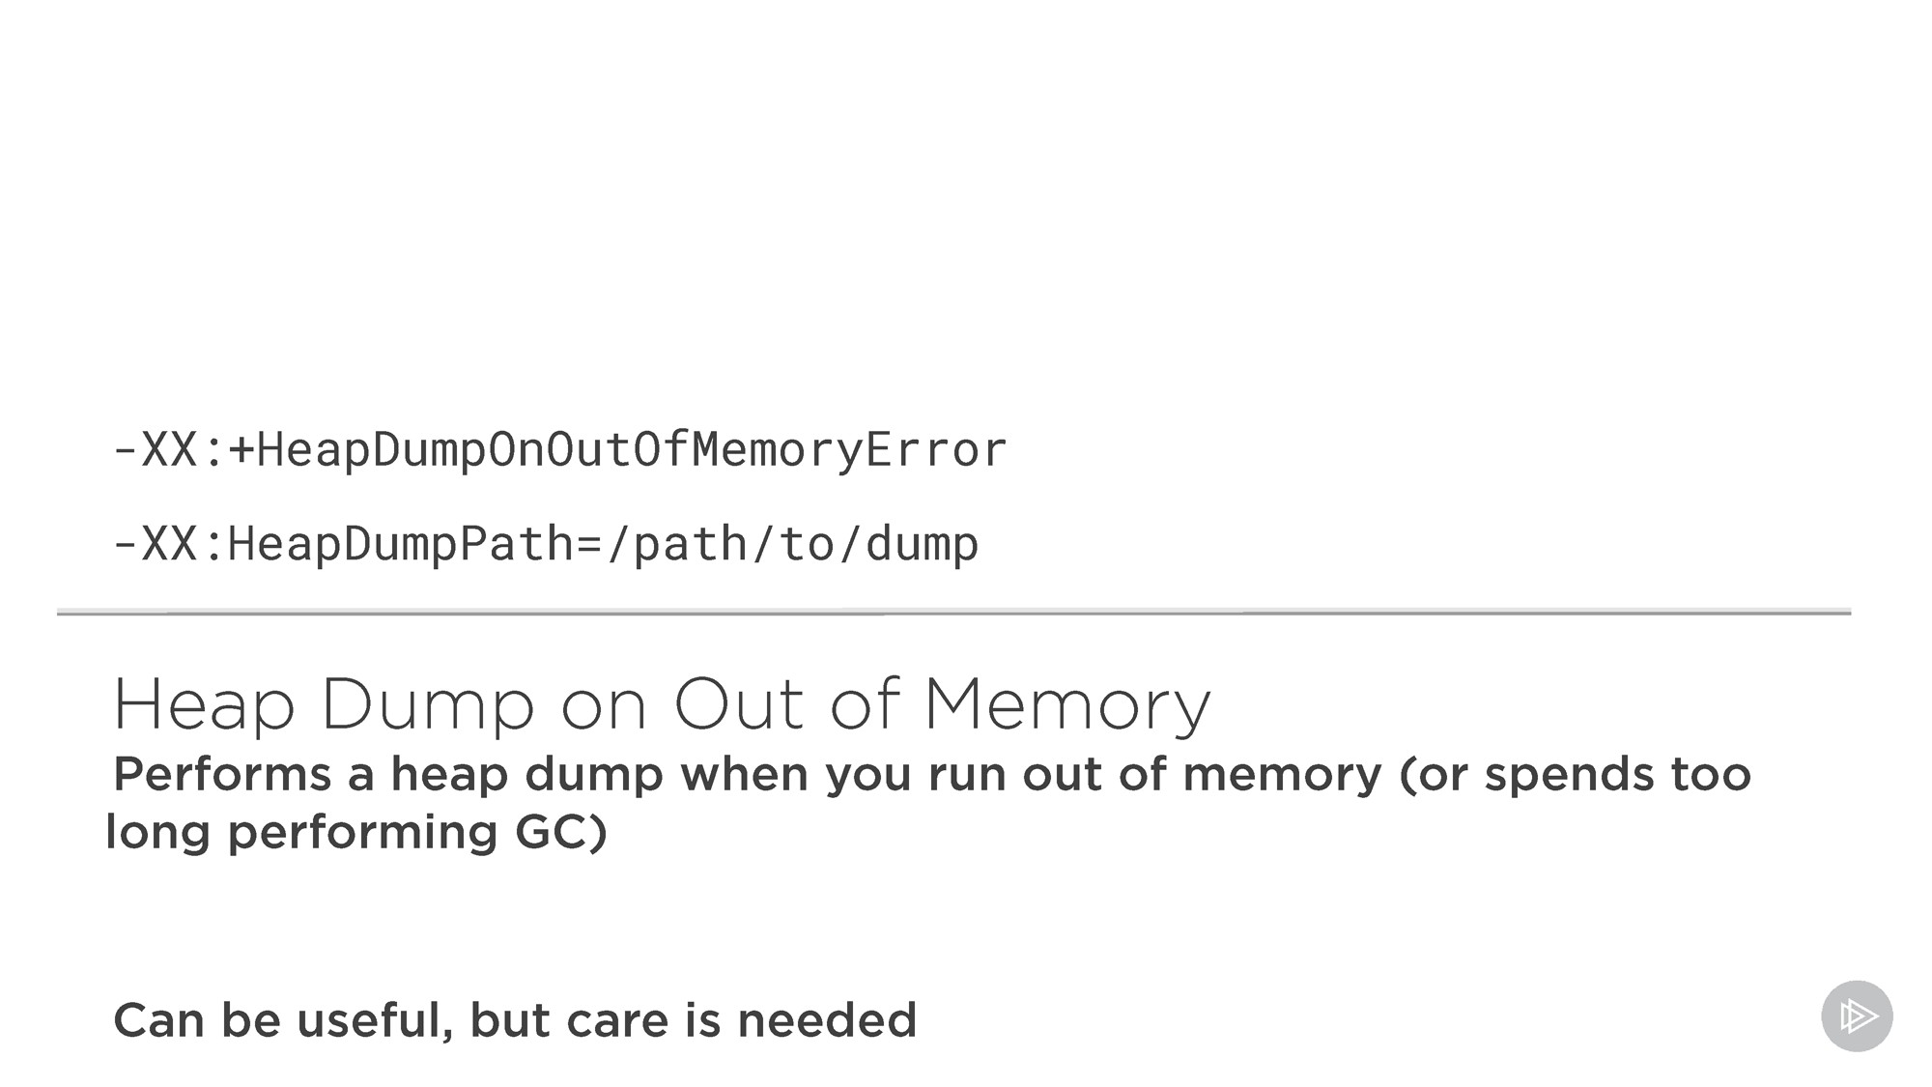
14

Slide 15
Eclipse Mat
Free Heap Dump Analyzer
http://eclipse.org/mat
Other Tools Usable
JVisualVM, jhat

Slide 16
Memory Profiling

Slide 17
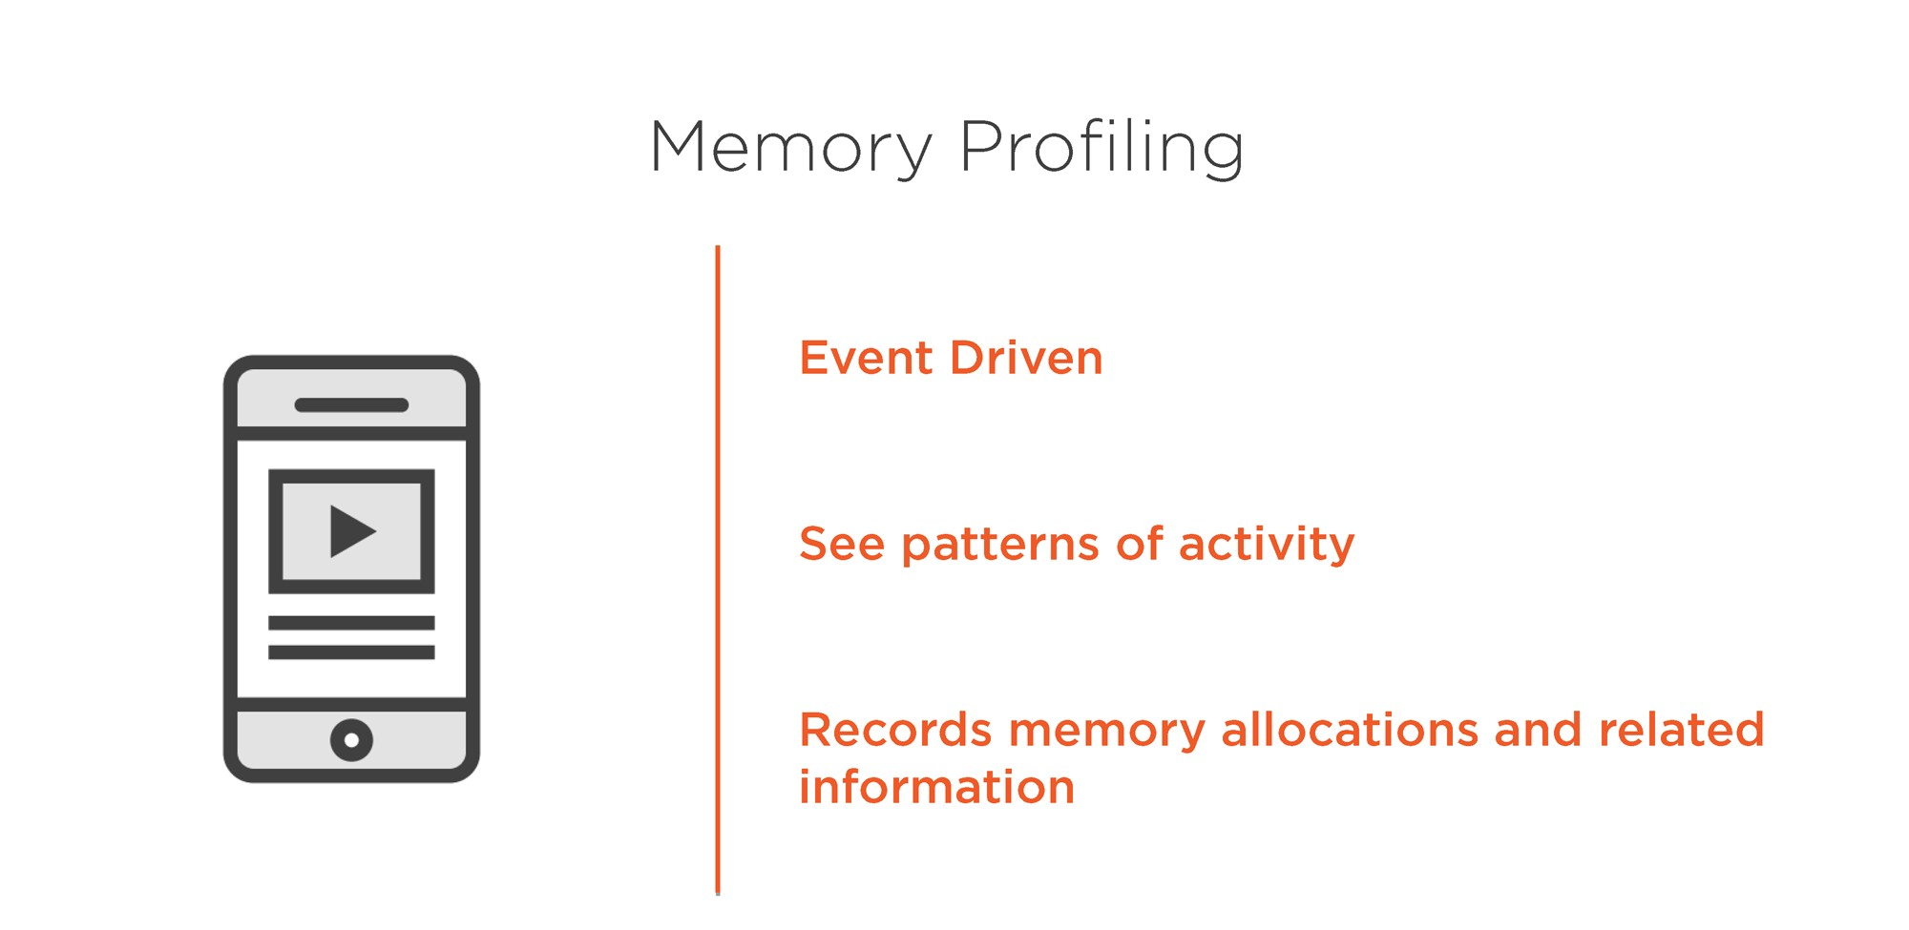

Slide 18
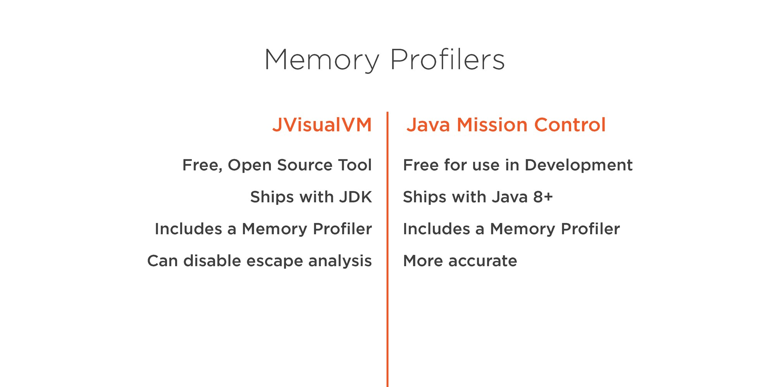

Slide 19

Learned about memory tooling
Summary
Memory Profiling with JVisual VM and Mission Control
Heap Dumps with MAT
jmap
jps
Time to solve some problems!

